Slide 1
Development Guide HD New FW

Slide 2
Contents
Create new module
Import module into framework (eclipse)
Custom layout
Build and run
Appendices
Author: phuongkim – Date: 14/03/2016

Slide 3
Development guide HD New FW
Create new module
Author: phuongkim – Date: 14/03/2016

Slide 4
>>Create new module Contents
Define package and class
Pom xml file
Module class
View provider class
Model class
Author: phuongkim – Date: 14/03/2016

Slide 5
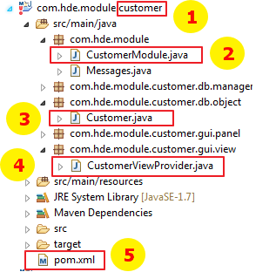
>> Create new module Define package and class
All packages and classes are defined like image
Module name (replace all “customer” to your module name)
Module class
Model class
View provider class
Pom xml file
Author: phuongkim – Date: 14/03/2016

Slide 6
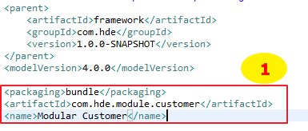
>> Create new module Pom xml file
Point to your module and define its name
Author: phuongkim – Date: 14/03/2016

Slide 7
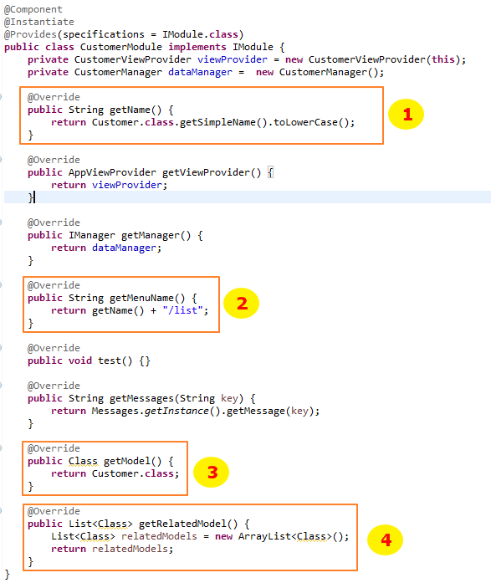
>> Create new module Module class
Declare your module name
Declare default view
Declare your model
Declare related models
Author: phuongkim – Date: 14/03/2016

Slide 8
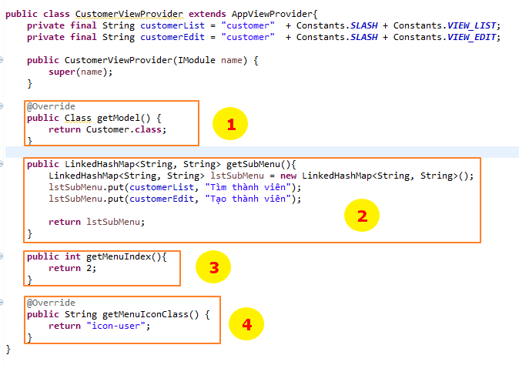
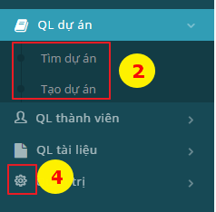
>> Create new module View provider class
Declare your model
Declare sub menu
Order menu
Set menu icon
Author: phuongkim – Date: 14/03/2016

Slide 9
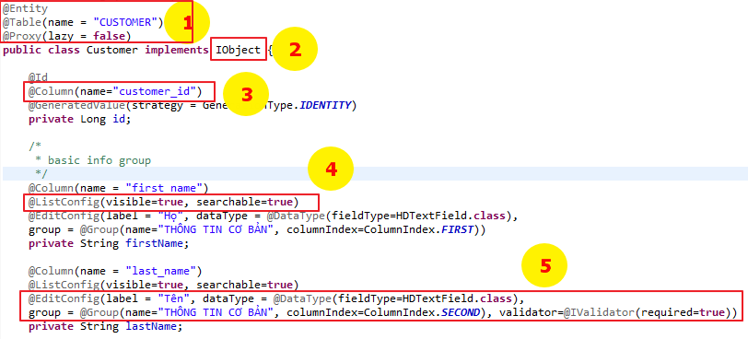
>> Create new module Model class
Declare necessary annotations (database table name)
Must implement from IObject interface
Declare database column name
Declare items which are showing on search screen
Declare items which are showing on edit and view screen
Author: phuongkim – Date: 14/03/2016

Slide 10
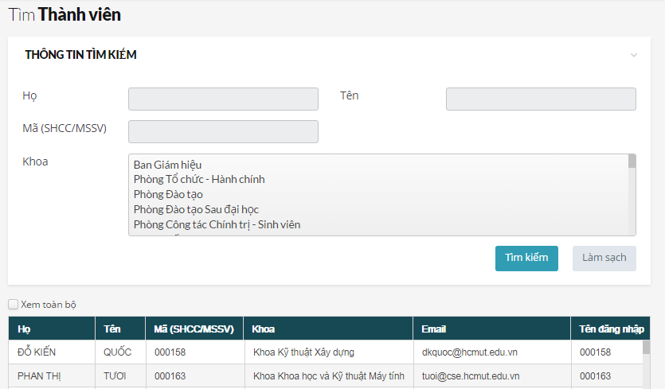
>> Create new module Model class – ListConfig attributes (1)
Author: phuongkim – Date: 14/03/2016

Slide 11
>> Create new module Model class – ListConfig attributes (2)
No. | Attribute (require) | Return type | Value | Description
1 | visible | boolean | True / false | Show column in list view
2 | queue | boolean | boolean | Set column wait for showing on list
3 | name | String | Any text | Display column header
4 | typeFormat | Class<? Extends Converter> | See “Converter component” | Format display value like email, number, date …
5 | defaultSort | String | ASC / DESC | Sort column value by ASC or DESC
6 | searchable | boolean | True / false | Show attribute on search panel
7 | customSearch + fieldType + fieldQuery + defaultSearch + clazzJoinLevel1 + clazzJoinLevel2 + propertyIDInJoinTable | @CustomSearch + Class + String + boolean + Class + Class + String | + See “Search component” + See “Define search query” + True / false | + Search field type + Search on field if there is a join + Default show in search panel + Join class at level 1 for writing query + Join class at level 2 fro writing query + Join attribute
8 | isMassUpdate | Boolean | True / false | Show in mass update panel
9 | columnIndex | int |  | Order column from left to right
10 | columnWidthPercent | int |  | Expand column with given percentage
Author: phuongkim – Date: 14/03/2016

Slide 12
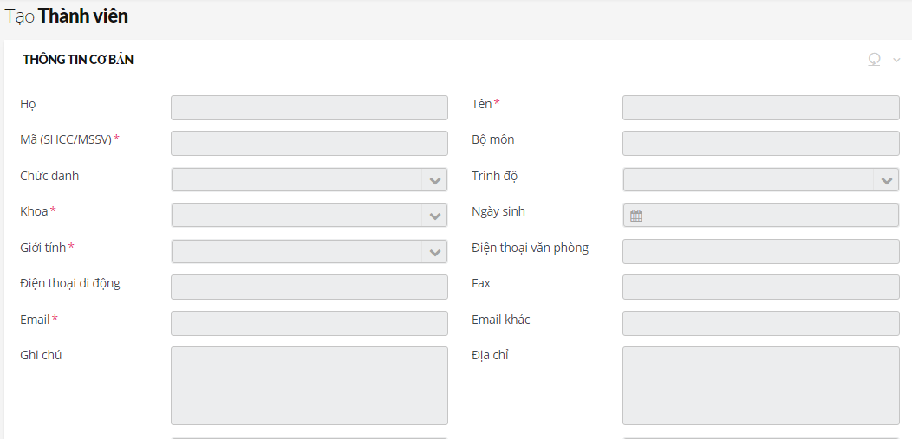
>> Create new module Model class – EditConfig attributes (1)
Author: phuongkim – Date: 14/03/2016

Slide 13
>> Create new module Model class – EditConfig attributes (2)
No. | Attribute (require) | Return type | Value | Description
1 | visible | boolean | True / false | Show column in list view
2 | system | boolean | True / false
3 | group + name + iconClass + groupIndex + viewOneColumnInInfoPanel | @Group + String + String + @ColumnIndex + boolean | + Any value + Class name + First / Second / Merge | Put some fields into group
4 | Lable (*) | String | Any text | Display field label
5 | dataType + fieldType + typeFormat + defaultValue | @Datatype + Class + Class + String | + See “component” + See “Converter component” + Any string | Set field type and set text input format
6 | description | String | Any value
7 | validator + typeValidator + required + minLength + maxLength + startDate + endDate | @Ivalidator + Class + boolean + int + int + String + String | - + extends Validator + True / false + Integer value + Integer value + Date as string value + Date as string value | Set validate for field + Custom validation + Set field require + Set min length + Set max length + Set start date (date field) + Set end date (date field)
Author: phuongkim – Date: 14/03/2016

Slide 14
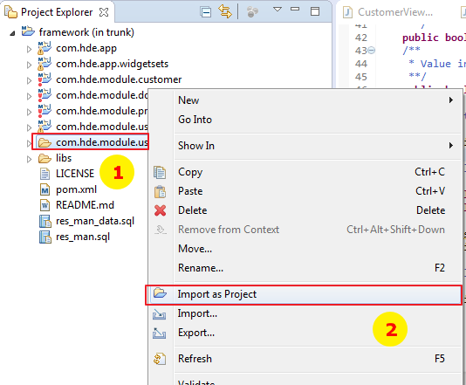
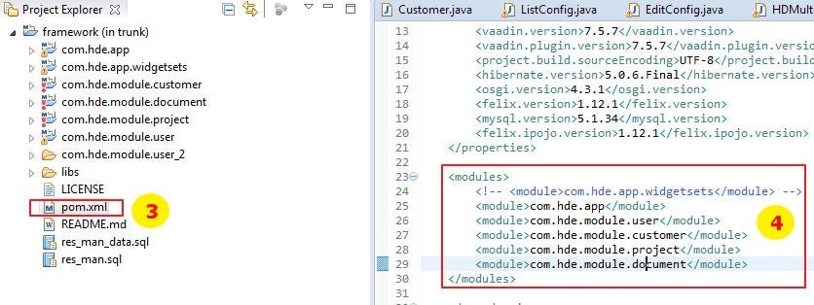
>> Import module into framework (eclipse)
Right click on module
Choose “Import as Project”
Open pom.xml of framework
Register new module
Author: phuongkim – Date: 14/03/2016

Slide 15
>> Custom layout
Author: phuongkim – Date: 14/03/2016

Slide 16
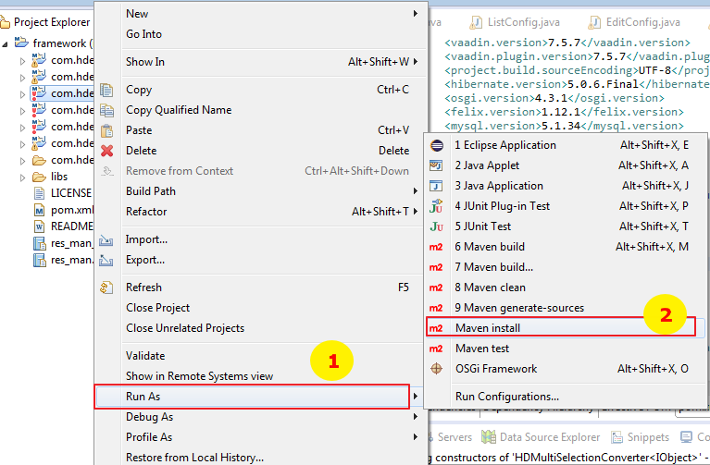
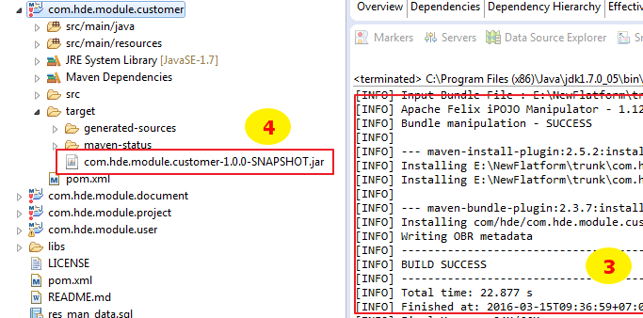
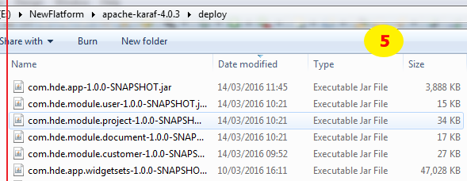
>> Build and run
Right click on module -> run as
Choose “Maven install”
Wait until build success
Copy jar file from target of module
Past to deploy folder of apache-karaf. Finally, you can run it on browser with url: http://localhost:8181/bk-resman
Author: phuongkim – Date: 14/03/2016

Slide 17
>> Appendices Components (1)
No. | Name | Search component | Description
1 | HDTextField | HDSearchTextField
2 | HDTextArea
3 | HDPhoneField
4 | HDPassword
5 | HDNumberField
6 | HDIntegerNumberField
7 | HDEmailField
8 | HDDateField | HDSearchDateRange
9 | HDCurrencyField
10 | HDItemCodeListSelect | HDSearchItemCodeListSelect
11 | HDItemCodeGroupRadio | HDSearchGroupRatio
12 | HDItemCodeGroupCheckbox
13 | HDItemCodeCombobox | HDSearchItemCodeComboBox
14 | HDFileUploader
Author: phuongkim – Date: 14/03/2016

Slide 18
>> Appendices Components (2)
No. | Name | Search component | Description
15 | HDSingleSelectionItemBox
16 | HDMultiSelectionItemBox
17 | HDComplexSelection
18 | HDRoleGroupCheckbox
Application is automatic convert edit component to search component. But we can use custom search component (place in fieldType of custom search annotation)
Author: phuongkim – Date: 14/03/2016

Slide 19
>> Appendices Converter components (1)
No. | Name | Description
1 | HDDateToStringConverter
2 | HDIDToIObjectConverter
3 | HDItemCodeConverter
4 | HDMultiIObjectConverter
5 | HDMultiItemCodeConverter
6 | HDStringToDateConverter
7 | HDMultiSelectionConverter
When we use converter component
+ Display custom format
+ Display other (not default) column of link table
Define new converter class, must extends from converter class
Author: phuongkim – Date: 14/03/2016

Slide 20
>> Appendices Define search query
Search query will be defined when there is a join with other table except item code table.
Example:
Author: phuongkim – Date: 14/03/2016

